Slide 1
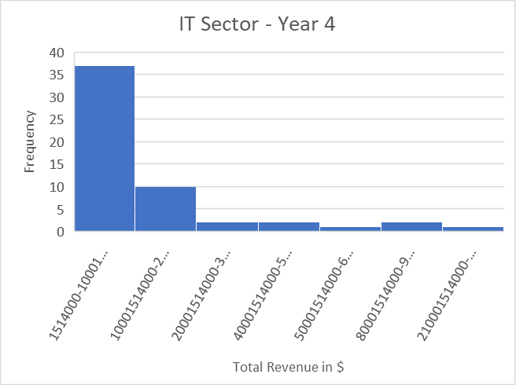
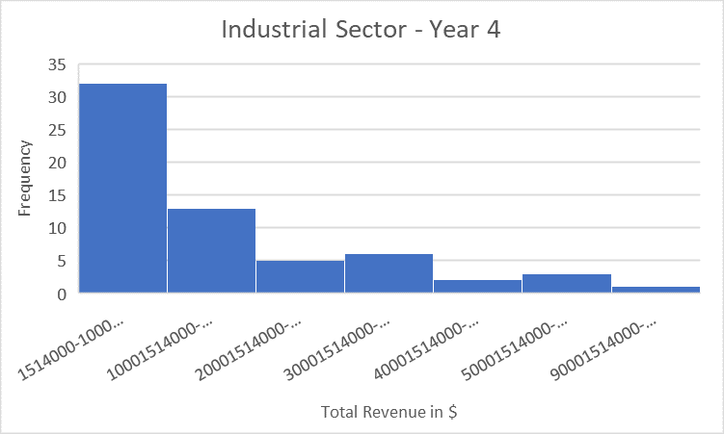
Does the IT sector’s total revenue is similar to the total revenue in the Industrial sector in year 4?
Here shows the histograms for the annual total revenue for IT sector and Industrial Sector companies reported for Year 4.
Both distributions are positively (Right) skewed. That means the mean for each is higher than the median.
The mean for the IT sector is about $16.5 billion whereas the mean for the industrial sector is slightly less at $16 billion. It looks like companies in the IT industry have a higher total revenue on average than all industries categorized under Industrial Sector. The median for IT is higher ($9.9 billion) than the median for the industrial sector ($5.5 billion). However, the standard deviation for the Industrial sector is higher ($32.9 billion) while the standard deviation for the IT sector is $17.7 billion. That means the variability in the industrial sector is higher compared to the IT sector. The range for the IT sector’s total revenue at $3.6 billion is higher than the range of total revenue for the industrial sector at only $4.1 billion. It looks like companies in the industrial sector have more significant variability in the total revenues they receive because their range is more spread out.

